Slide 1

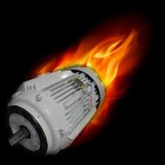
TEAM MEMBERS: Shifa mallebhari ritesh swami I Shashank reddy Rince Sabu pola Madhu Sudhan tanmay janrao
PROJECT P496 GROUP-4
ELECTRIC MOTOR TEMPERATURE

Slide 2
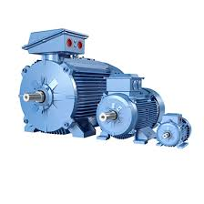
agenda
EDA
Model building –(Random Forest, Neural Network, Multi-linear Regression, Decision Tree, XG Boost, Light GBM)
Model deployment
conclusion

Slide 3
Exploratory Data Analysis (EDA) of Motor Speed Dataset
Data Understanding: Identifying patterns, trends, and relationships.
We're working with a dataset of [1,330,816] rows and 12 key features related to motor performance.
Features include ambient temperature, coolant temperature, voltage (u_d, u_q), motor speed, torque, current (i_d, i_q), and various temperature readings (PM, stator yoke, tooth, winding).
Data quality is high: there are no missing (null) values in the dataset.
Crucially, an initial check revealed no duplicate rows in the dataset. This ensures data integrity for further analysis.
Exploratory Data Analysis (EDA) is the initial step in data analysis that helps you understand the structure, patterns, relationships, and quality of the data before applying any complex algorithms. It involves:
Data Cleaning: Handling missing values, outliers, and errors

Slide 4
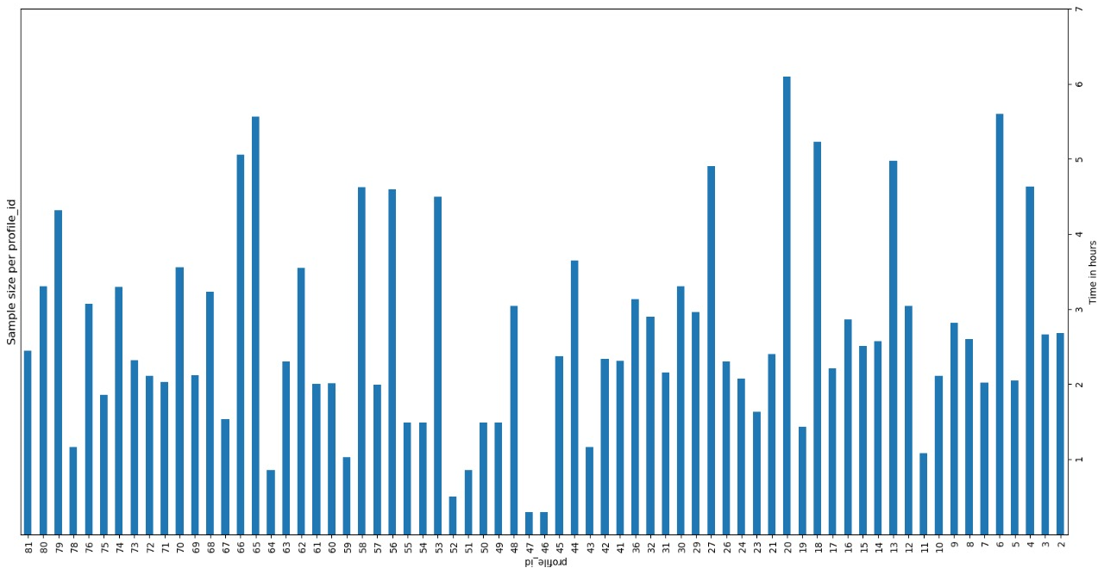
Sample Size Trends Over TimeTrend: Sample sizes start at 81 and decrease over 7 hours, with fluctuations (e.g., drop from 36 to 32).
Range: Sizes vary from 1 to 81 per profile ID. Implications: Decreasing trend suggests potential data collection challenges; fluctuations may impact analysis reliability.
Recommendation: Improve consistency in data collection and monitor sample sizes regularly.
Visual: Include the image with clear axes : X-axis: Time in hours (1 to 7).Y-axis: Sample size per profile ID (1 to 81).
Highlight key points: highest (81), lowest (1), and significant drops.

Slide 5

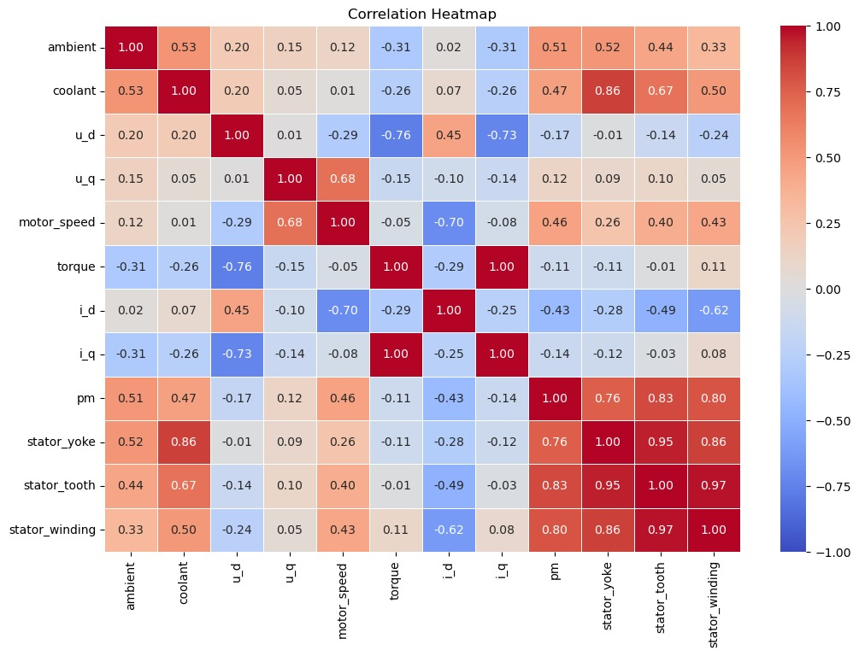
Correlation Heatmap
Strong Positives:
Stator components (yoke, tooth, winding) highly correlated (0.86–0.97).
pm strongly linked to stator (0.76–0.83).
2. Strong Negatives:
torque and i_d inversely related (-0.70).
u_d and i_q show opposing effects (-0.73).
3. Weak/No Correlation:
ambient and i_d near-zero (0.02).
Key Takeaway:
Stator and pm are interdependent; torque and current show inverse behavior.

Slide 6
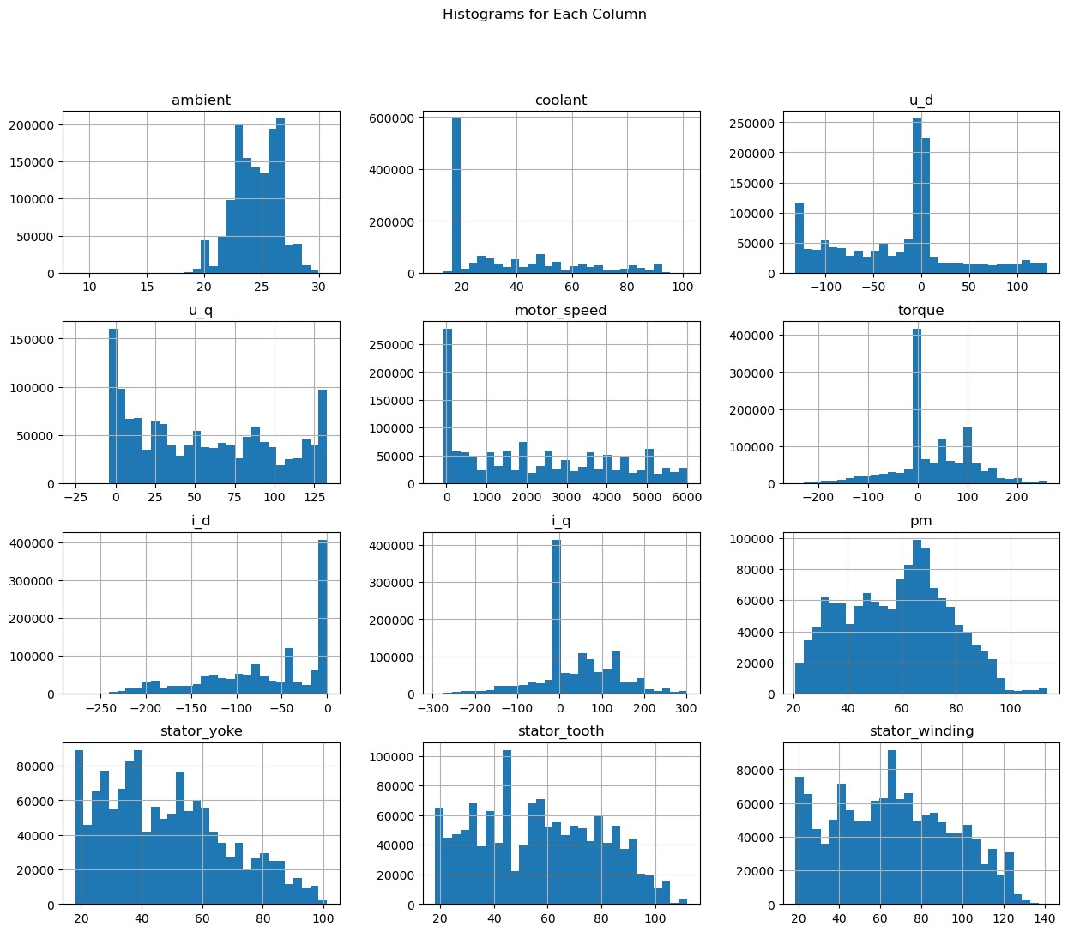
Histogram Distributions
ambient: Peaks at 10–30 (normal/skewed)
coolant: Right-skewed, peaks at 20–60.
motor_speed: Uniform spread (0–100).
torque: Symmetrical around 0.
stator_yoke: Bimodal, peaks at 20–100.
Key Takeaway:
Most parameters operate within stable ranges, but outliers highlight areas needing attention.
Parameters like i_q and i_d shows extreme values, suggesting potential stress points and anomalies

Slide 7
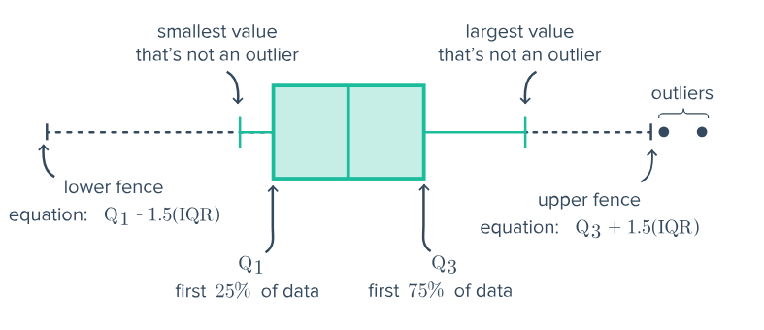
Outlier Handling with IQR & Trimming
1. Method Used:
IQR (Interquartile Range): Robust for non-normal data.
Outliers defined as values outside Q1 - 1.5×IQR and Q3 + 1.5×IQR.
2. Approach:
Trimming: Outliers removed to reduce skewness.
3. Impact:
Original Dataset: 1,330,816 rows.
Outliers Removed: 67,621 rows (5%).
Final Dataset: 1,263,195 rows.
4. Why Trimming?:
5% data loss is not that significant.
Ensures cleaner data for analysis without major impact on dataset size.
5. Conclusion:
Trimming with IQR is effective for this dataset, balancing outlier removal and data retention.

Slide 8
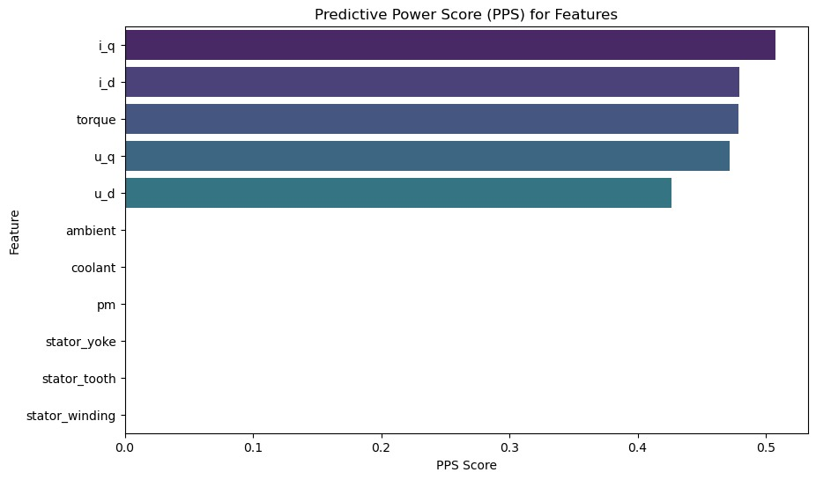
Predictive Power Score (PPS) Analysis for Motor Speed
Top 5 Features Affecting Motor Speed
i_q (Quadrature-axis current) → 0.507 (Most influential)
i_d (Direct-axis current) → 0.479
Torque → 0.479
u_q (Quadrature-axis voltage) → 0.472
u_d (Direct-axis voltage) → 0.427
Model & Performance
Model Used: DecisionTreeRegressor
Evaluation Metric: Mean Absolute Error (MAE)
Baseline MAE: 1598.89
Optimized MAE: 787.73 (Significant improvement)
Key Takeaways Current (i_q, i_d) & Voltage (u_q, u_d) are the strongest predictors
Torque also plays a major role in motor speed
Temperature-related features (ambient, coolant, stator components) have NO predictive power
Conclusion: Focusing on electrical parameters like current & voltage can significantly enhance motor speed predictions!

Slide 9
A random forest (RF) is an ensemble of decision trees in which each decision tree is trained with a specific random noise.
MODEL BUILDING
RANDOM FOREST
Model training:
Random forest regressor initialized with 20 trees.
Model trained on scaled training data.
Key observations:
The model has a high R² score, indicating excellent predictive performance.
Low mse and rmse values suggest minimal error.
Out-of-bag (oob) score provides an unbiased estimate of model accuracy.
Model evaluation:
R² score: 0.9998
Mean squared error (MSE): 0.0002
Root mean squared error (RMSE): 0.0142
Out-of-bag (OOB) score: 0.9997
Visuals:
Scatter plot of actual vs. Predicted values.
Include a brief note on the significance of r², mse, and rmse.

Slide 10
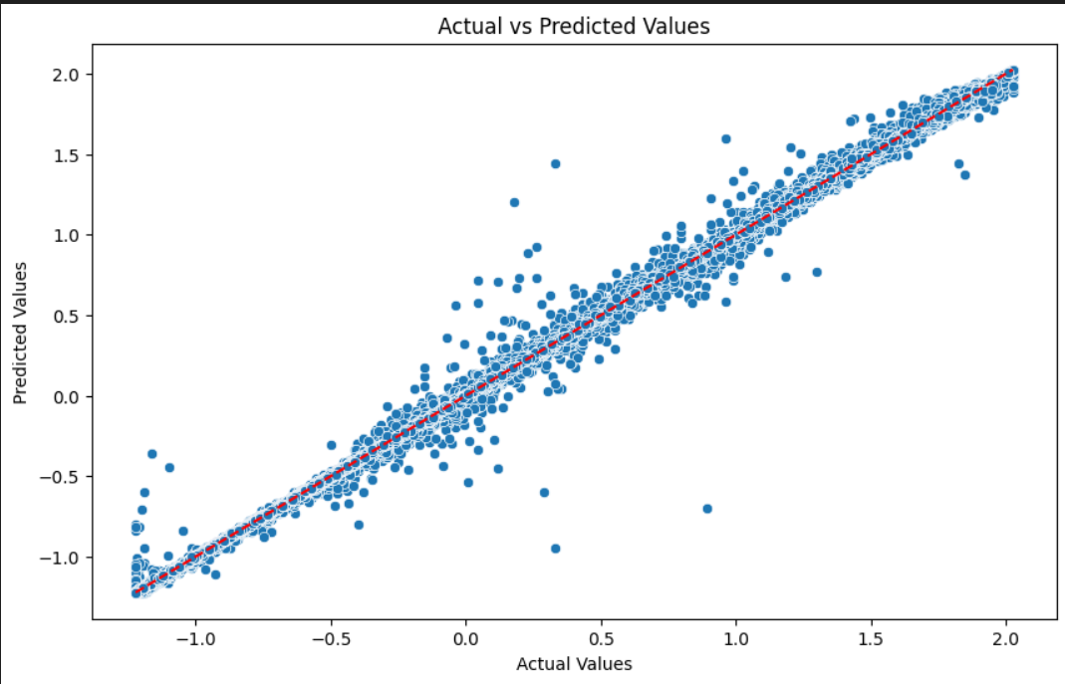
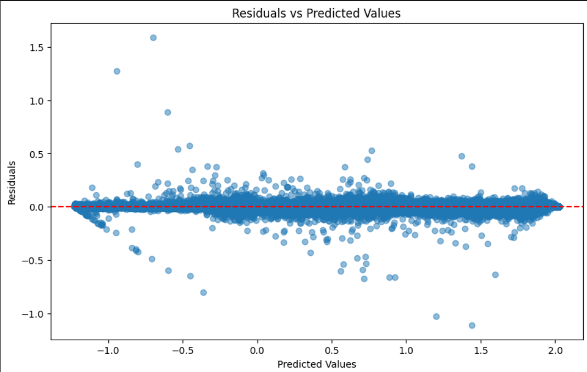
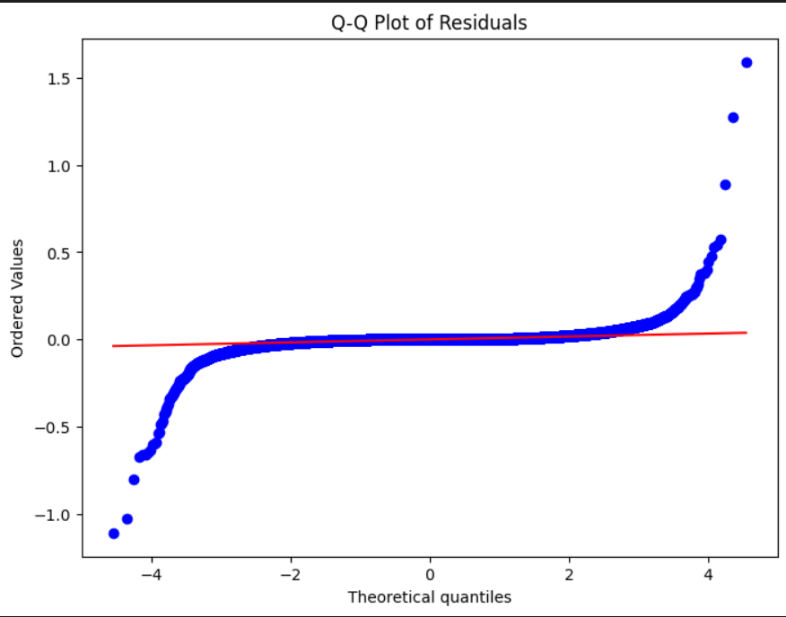
Residual Analysis & Actual vs Predicted Plot
Scatter plot: Actual vs Predicted values
Residuals vs Predicted Values:
Random distribution of residuals → Suggests homoscedasticity
No clear pattern → Indicates well-behaved residuals
Q-Q Plot Interpretation:
Residuals follow a normal distribution, validating model assumptions.

Slide 11
A neural network is a machine learning program, or model, that makes decisions in a manner similar to the human brain, by using processes that mimic the way biological neurons work together to identify phenomena, weigh options and arrive at conclusions.
NEURAL NETWORK
Model Overview: Neural Network architecture
Input Layer: 64 neurons (ReLU activation)
Hidden Layer 1: 128 neurons (ReLU activation) with Dropout (20%)
Hidden Layer 2: 64 neurons (ReLU activation)
Output Layer: 1 neuron (for regression)Key observations:
Model evaluation:
Mean Squared Error (MSE): 0.0327
Root Mean Squared Error (RMSE): 0.1809
R² Score: 0.9673

Slide 12
Multiple linear regression (MLR) is a statistical technique that uses several explanatory variables to predict the outcome of a response variable.
MULTI-LINEAR REGRESSION
Model performance metrics:
Mean squared error (MSE): 0.0562
Root mean squared error (RMSE): 0.2371
R² score: 0.9439
Key Observations:
The R² score of 0.9439 indicates a good fit.
RMSE of 0.2371 suggests moderate prediction error.
The model performs well but may not capture complex relationships.

Slide 13
A decision tree is a non-parametric supervised learning algorithm, which is utilized for both classification and regression tasks. It has a hierarchical, tree structure, which consists of a root node, branches, internal nodes and leaf nodes.
DECISION TREE
Initial model performance metrics:
R² score: 0.9996
Mean squared error (MSE): 0.0004
Root mean squared error (RMSE): 0.0211
Final model performance metrics:
R² score: 0.9996
Mean squared error (MSE): 0.0004
Root mean squared error (RMSE): 0.0201
Hyperparameter tuning:
1) GridSearchCV Best Parameters:
max_depth: None, max_features: None
min_samples_leaf: 4, min_samples_split: 2
Testing R²: 0.9996, MSE: 0.0004, RMSE: 0.0197
•2) BayesSearchCV Best Parameters:
max_depth: 49, min_samples_leaf: 3,
min_samples_split: 2, max_features: None
Testing R²: 0.9996, MSE: 0.0004, RMSE: 0.0201

Slide 14
A LightGBM is a powerful and fast machine learning algorithm designed for classification and regression tasks, especially with large datasets.it is uses decision trees and gradient boosting to make accurate predictions while being efficient in memory and computation.
LIGHT
GRADIENT
BOOSTING
MACHINE
(LGBM)
Data Pre-processing:
Feature Selection- Target variable is motor_speed, rest as the columns serve as features.
Data Standardization- The selected features are standardized using StandardScalar to improve model performance and uniform scaling.
Final model performance metrics:
R² score: 0.996
Mean squared error (MSE): 0.0039
Mean absolute error (MAE): 0.0300
Cross Validation mean R² :0.9958
Model Training & Testing:
Data Splitting- The dataset is split into training(80%) and Testing(20%) sets using train_test_split( ).
Model Training- LightGBM Regressor model is trained using the standardized training data with following
Hyperparameter:
Learning_rate=0.09 , n_estimators=100,max_depth=3
Conclusion:
LGBM model effectively predicts motor_speed with a good balance between bias and variance.
Feature selection and scaling significantly improved model performance.
Further hyperparameter tuning or feature engineering can enhance accuracy.

Slide 15
Xgboost (extreme gradient boosting) is a powerful machine learning algorithm based on gradient boosting. It is efficient, fast, and widely used for regression and classification tasks due to its ability to handle missing values, prevent overfitting, and optimize performance.
EXTREME GRADIENT BOOSTING (XGBOOST)
Data preparation :
The dataset contains multiple features and a target variable (motor_speed).
Splitting data into features and target for training/testing.
Ensuring reproducibility with a fixed random state.
Feature scaling :
Standardization enhances model performance.
Prevents test data leakage by using training statistics.
Model training & prediction:
Xgboost handles complex patterns efficiently.
The model is trained and used for prediction.
Evaluation :
R² score: measures model fit.
Mse & rmse: assess prediction errors.
Results :
Performance metrics:
R² score: 0.9995
Mse: 0.0005
Rmse: 0.0222
Model demonstrates near-perfect predictions.
Conclusion :
Proper preprocessing improves model accuracy.
Xgboost is highly effective for motor speed prediction.

Slide 16
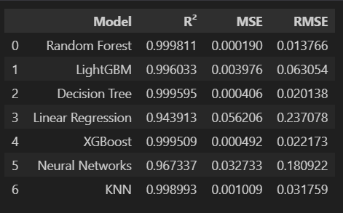
Comparison & conclusion of model building
✅Best performing model:
Random Forest has the highest r² (0.9998) and the lowest RMSE (0.0138), making it the most accurate model.
Decision Tree and XGBoost also show strong performance, but slightly worse than random forest.
⚠ Moderate performance:
KNN and LGBM show good performance but have slightly higher RMSE values.
❌ Poor performing models:
Linear Regression and Neural Networks show relatively lower r² values and higher error metrics, indicating they are not the best choices for this dataset.
Conclusion:
The Random Forest model outperforms all other models in terms of accuracy and error metrics, making it the preferred choice for this dataset.
Decision Tree and XGBoost are also strong contenders, while Linear Regression and Neural Networks may require further tuning or alternative approaches to improve their performance.

Slide 17
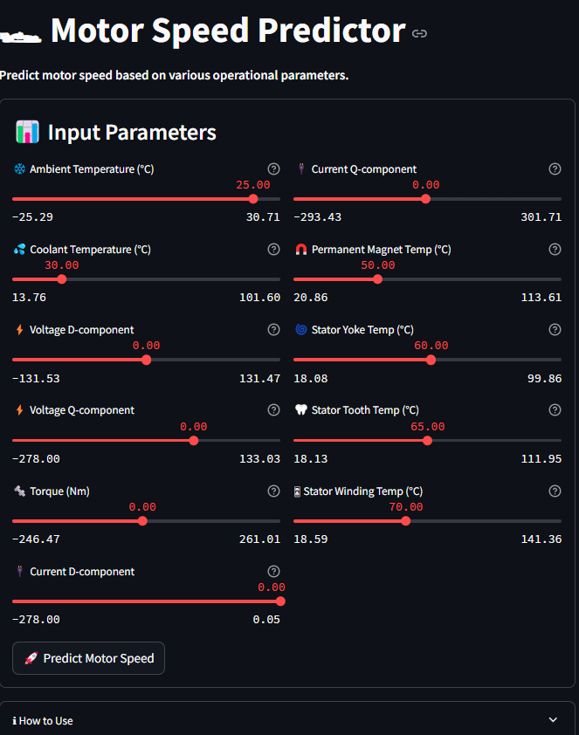
Model Deployment
Overview:
A Streamlit application designed to predict motor speed based on various operational parameters.
Users can input values for different parameters using sliders.
Prediction Process:
Model and scalers are loaded from saved files.
Input values are scaled and fed into the trained model.
The predicted motor speed is displayed to the user.
User Instructions:
Adjust the slider values for each parameter.
Click the "Predict Motor Speed" button.
View the predicted motor speed and modify inputs for different scenarios.

Slide 18
CONCLUSION
This project successfully predicted motor speed using machine learning, focusing on data preprocessing, model selection, and deployment. Key steps included outlier handling, feature selection (VIF, RFE, PPS), and testing seven algorithms, with Random Forest achieving the lowest RMSE and MSE.
The model was deployed using Streamlit, featuring sliders for input, caching for faster predictions, and joblib for model persistence. The solution is scalable, efficient, and applicable in industries like automotive, manufacturing, and energy. Future improvements include real-time sensor data, advanced models, and interactive visualizations for enhanced insights.

Slide 19

Thank you

